Slide 1
http://www.vidyanidhi.com/
ketkiacharya.net@gmail.com
Ketki Acharya
From: SM VITA ATC of CDAC
9769201036
ketkiacharya.net@gmail.com

Slide 2
Vita{
Class DAC{
}
}
Vita.DAC
Import vita from ‘./vita’

Slide 3
ES8 #--private variable
<script>
‘use strict'
class Account
{ #name;
#balance;
constructor(name,amt)
{
this.#name=name;
this.#balance=amt;
alert(typeof this.constructor)
}
toString()
{return `Name=${this.#name} Bal=${this.#balance}`
}
}
/*toString()
{return “Name=“+this.#name+ “Bal=“+this.#balance;}*/
var obj1=new Account("raj",20000);
console.log(obj1);
document.write(obj1 instanceof Account);//true
document.write(obj1 instanceof Object);//true
//obj1.#name="geeta";
console.log(obj1);
document.write(obj1); //geeta 20000
var obj2=new Account("Mona",50000);
console.log(new Object());
</script>
Object
this.#name=raj
this.#balance=20000
obj1
obj1
this.#name=mona
this.#balance=50000
document.write(obj1); // //geeta 20000
Internally calling toString() method.
- Account class does have this method
So it will call toString() method.
alert(typeof this.constructor)
Above line says it is function So…
Can I call Account() directly ?
No you will get error
Default value in private instance member?
Undefined
Can I access #name out side class?
NO
Uncaught SyntaxError: Private field '#name' must be declared in an enclosing class

Slide 4
ES8 _--protected variable
<script>
‘ use strict'
class Account
{ _name;
_balance;
constructor(name,amt)
{ this._name=name;
this._balance=amt;
alert(typeof this.constructor)
}
toString()
{return `Name=${this._name} Bal=${this._balance}` }
}
var obj1=new Account("raj",20000);
console.log(obj1);
document.write(obj1 instanceof Account);//true
document.write(obj1 instanceof Object);//true
obj1._name="geeta";
document.write(obj1); //object Object
var obj2=new Account("Mona",50000);
</script>
Object
obj1
this.name=raj geeta
this.balance=20000
obj2
this.name=mona
this.balance=50000
document.write(obj1); // //geeta 20000
Internally calling toString() method.
- Account class does have this method
So it will call toString() method.
alert(typeof this.constructor)
Above line says it is function So…
Can I call Account() directly as function?
No you will get error
Default value in private instance member?
Undefined
_name is available out side the class but need no use.
Use it only in child class
Is instance member required [above constructor] ?
No

Slide 5
Inheritance _protected
Parent
Child
class Account
{ _firstname;
_lastname;
_balance;
constructor(fname,lname,amt)
{ this.firstname=fname;
this.lastname=lname;
this.balance=amt;
}
set firstname(value) {this._firstname=value;}
get firstname(){ return this._firstname;}
set balance(value) {this._balance=value;}
get balance(){ return this._balance;}
set lastname(value) {this._lastname=value;}
get lastname(){ return this._lastname;}
deposit(amt)
{ this. balance +=amt; }
toString() { return this.firstname+ " " + this.lastname+" "+this.balance}
}
class Savingaccount extends Account
{type;
constructor(acctype,fname,lname,amt)
{ super(fname,lname,amt)
this.type=acctype;
}
withdraw(amt)
{ const minbal=1000;
if(amt>(this.balance-minbal))
throw new TypeError("err");
this.balance-=amt;
}
}
Object
Account
deposit(amt){ }
toString()
get firstname(){
set firstname(){
var obj=new Savingaccount ("sav","Raj","Mathur",2000)
obj.deposit(2000);
document.write(obj);
obj.withdraw(500);
document.write(obj);
document.write(obj.balance);
Obj.balance=50000;
Savingaccount
this. ._firstname =raj
this. ._lastname -Mathur
this. ._balance =20000
this.Type=sav
withdraw
obj1

Slide 6
Complete application
class Savingaccount extends Account
{ type;
constructor(acctype,fname,lname,amt)
{ super(fname,lname,amt)
this.type=acctype;
}
withdraw(amt)
{ const minbal=1000;
if(amt>(this._cbalance-minbal))
throw new TypeError("err");
this._cbalance=this._cbalance-amt;
}
}
<script> ‘use strict’
class Account {
#firstname; #lastname;
#balance; #id;
static #aid=0; constructor(fname,lname,amt)
{ this.firstname=fname;
this.lastname=lname;
this. _cbalance =amt;
this.#id=++Account.#aid;
}
set firstname(value) {this.#firstname=value;}
get firstname(){ return this.#firstname;}
set _cbalance(value) {this.#balance=value;}
get _cbalance(){ return this.#balance;}
set lastname(value) {this.#lastname=value;}
get lastname(){ return this.#lastname;}
get gid(){ return this.#id;}
deposit(amt)
{ this. _cbalance +=amt; }
toString() { return this.gid + " "+ this.firstname+ " " + this.lastname+" "+this._cbalance}
}
var obj=new Savingaccount ("sav","Raj","Mathur",2000)
obj.deposit(2000);
document.write(obj);
obj.withdraw(500);
document.write(obj);
//obj.gid=101;

Slide 7
Object
External memory
Static aid =0 1 2
Static coname=“vidyanidhi”
Static rateofint=0.08
Static payinterest( obj)
Account
deposit(amt){ }
obj
toString()
get firstname(){
set firstname(){
Savingaccount
this. .firstname =raj
this. .lastname -Mathur
this. ._balance =20000
This.#id=1
this.Type=sav
withdraw
obj

Slide 8
In the above example we have declare static variable to generate account id.
this.#id=++Account.aid;
In the above line we can access static variable with class name.
get gid(){ return this.#id;}
We have written only getter property as user can read Id but can not set it. Generally account number is given by bank.
We have declare instance member private in a class and achieve data hiding, encapsulation.
set _cbalance(value) {this.#balance=value;}
get _cbalance(){ return this.#balance;}
We purposely declared get set _cbalance so that programmer should not use this variable outside the class. But only child class can access it.
In bank you can read balance but you can not set balance. So should I write getter only?? Think how you will set value when user deposit money?
So you need getter and setter both. You just want to ensure that it should be available only to child class. So we are using _balance so that it is reminder to programmer that this variable need not used outside class.

Slide 9
Private method/private static variable
Private instance methods
Private instance methods are methods available on class instances whose access is restricted in the same manner as private instance fields.
<script>
class ClassWithPrivateMethod {
#privateMethod() {
return 'hello world'
}
getPrivateMessage() {
return this.#privateMethod()
}
}
const instance = new ClassWithPrivateMethod()
console.log(instance.getPrivateMessage())
// expected output: "hello world"
</script>

Slide 10
Private getters and setters are also possible:
class ClassWithPrivateAccessor {
#message
get #decoratedMessage() {
return `${this.#message}`
}
set #decoratedMessage(msg) {
this.#message = msg
}
constructor() {
this.#decoratedMessage = 'hello world'
console.log(this.#decoratedMessage)
}
}
let Obj=new ClassWithPrivateAccessor();

Slide 11
the limitation of static variables being called by only static methods still holds.
class ClassWithPrivateStaticField {
static #PRIVATE_STATIC_FIELD
static publicStaticMethod() {
ClassWithPrivateStaticField.#PRIVATE_STATIC_FIELD = 42
return ClassWithPrivateStaticField.#PRIVATE_STATIC_FIELD
}
}
console.log(ClassWithPrivateStaticField.publicStaticMethod() === 42)
Private static fields are added to the class constructor at class evaluation time.
There is a provenance restriction on private static fields. Only the class which defines the private static field can access the field.
This can lead to unexpected behavior when using this.

Slide 12
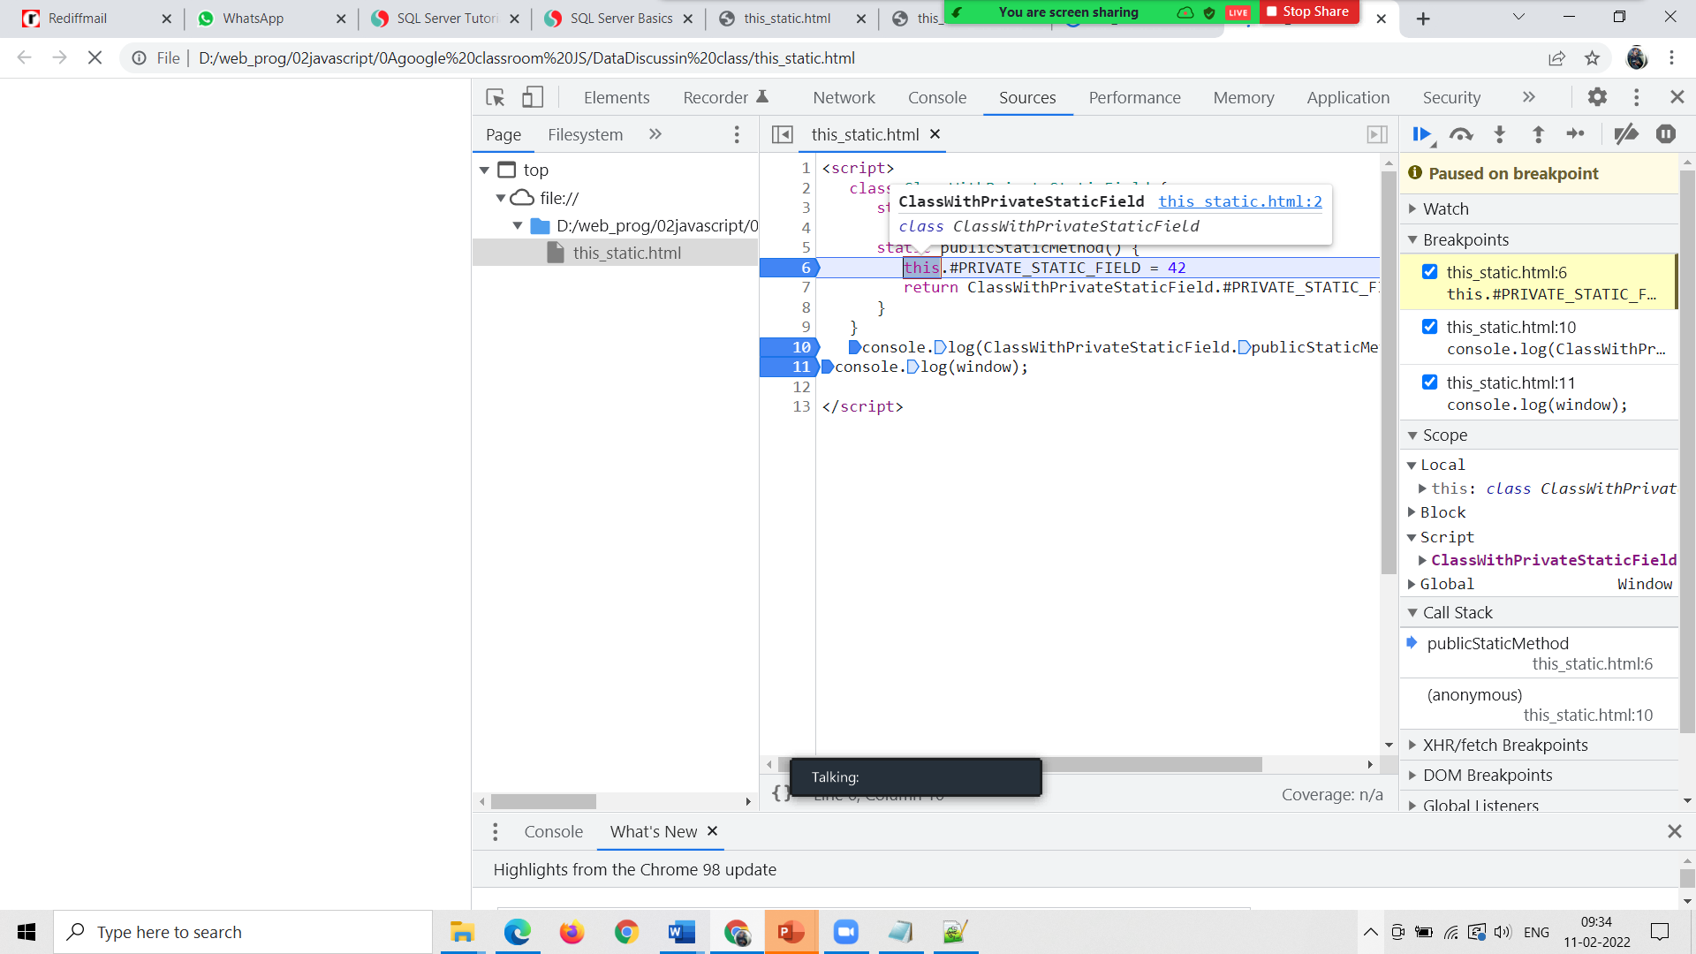
Private static methods
Like their public equivalent, private static methods are called on the class itself, not instances of the class. Like private static fields, they are only accessible from inside the class declaration.
Private static methods may be generator, async, and async generator functions.
class ClassWithPrivateStaticMethod {
static #privateStaticMethod() {
return 42
}
static publicStaticMethod1() {
return ClassWithPrivateStaticMethod.#privateStaticMethod();
}
static publicStaticMethod2() {
return this.#privateStaticMethod();
}
}
console.log(ClassWithPrivateStaticMethod.publicStaticMethod1() === 42);
console.log(ClassWithPrivateStaticMethod.publicStaticMethod2() === 42);

Slide 13
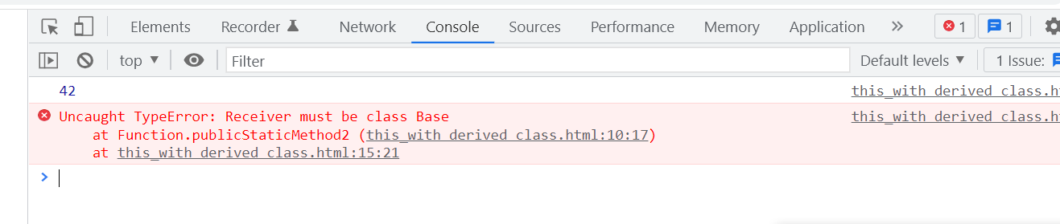
This can lead to unexpected behavior when using this. In the following example this refers to the Derived class (not the Base class) when we try to call Derived.publicStaticMethod2(), and thus exhibits the same "provenance restriction" as mentioned above:
class Base {
static #privateStaticMethod() {
return 42;
}
static publicStaticMethod1() {
return Base.#privateStaticMethod();
}
static publicStaticMethod2() {
return this.#privateStaticMethod();
}
}
class Derived extends Base {}
console.log(Derived.publicStaticMethod1()); // 42
console.log(Derived.publicStaticMethod2()); // TypeError

Slide 14
Using Import export
To create module save this file as account.mjs
export class Account
{
#firstname;
#lastname;
#balance; #id;
static #aid=0;
constructor(fname,lname,amt)
{this.firstname = fname;
this.lastname=lname;
this. _cbalance =amt;
this.#id=++Account.#aid;
}
set firstname(value) {this.#firstname = value;}
get firstname(){ return this.#firstname;}
set _cbalance(value) {this.#balance = value;}
get _cbalance(){ return this.#balance;}
set lastname(value) {this.#lastname = value;}
get lastname(){ return this.#lastname;}
get gid(){ return this.#id;}
deposit(amt)
{this._cbalance += amt; }
toString() { return this.gid + " "+ this.firstname+ " " + this.lastname+" "+this._cbalance}
}

Slide 15
Following file is Savingaccount.mjs and use.mjs
import { Account } from "./Account.mjs";
export class Savingaccount extends Account {
type;
constructor(acctype, fname, lname, amt) {
super(fname, lname, amt)
this.type = acctype;
}
withdraw(amt) {
const minbal = 1000;
if (amt > (this._cbalance - minbal))
throw new TypeError("err");
this._cbalance = this._cbalance - amt;
}
}
import { Savingaccount } from "./Saving.mjs";
const sobj=new Savingaccount("sav","raj","Mathur",5000);
console.log(sobj.toString());
sobj.withdraw(1000);
console.log(sobj);
Run from command prompt
node use.mjs

Slide 16
yield
0 | 1 | 2 | 3 | 4
1 | 2 | 3 | 4 | 5
sides
class Polygon {
constructor(...sides) {
this.sides = sides;
}
// Method
*getSides() {
for(const side of this.sides){
yield side;
}
}
}
const pentagon = new Polygon(1,2,3,4,5);
console.log([...pentagon.getSides()]); // [1,2,3,4,5]
pentagon
*getSides()

Slide 17
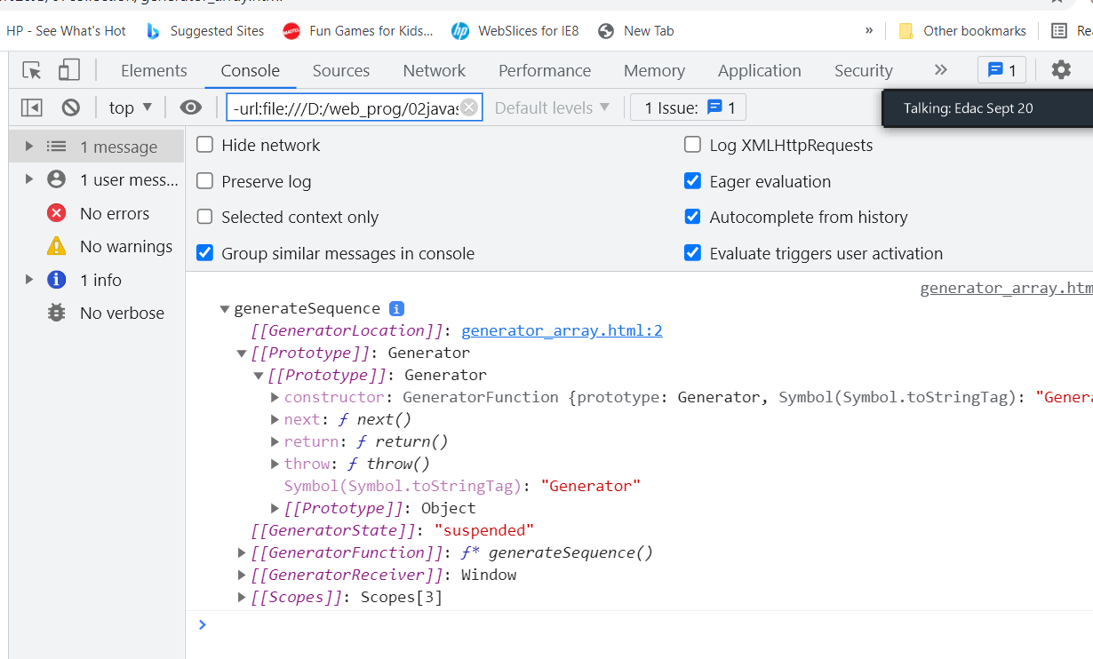
<script>
function* generateSequence() {
yield 1;
yield 2;
yield 3;
}
let sequence = [...generateSequence()];
alert(sequence); // 0, 1, 2, 3
</script>
The yield keyword pauses generator function execution and the value of the expression following the yield keyword is returned to the generator's caller. It can be thought of as a generator-based version of the return keyword. ... A yield , which causes the generator to once again pause and return the generator's new value.
console.log(generateSequence())

Slide 18
<script>
class MyClass {
*createIterator() {
yield 1;
yield 2;
yield 3;
}
}
let instance = new MyClass();
let iterator = instance.createIterator();
console.log(iterator);
let one=iterator.next();
alert(JSON.stringify(one));
let two=iterator.next();
alert(JSON.stringify(two));
let three=iterator.next();
alert(JSON.stringify(three));
let four=iterator.next();
alert(JSON.stringify(four));
generator
Next()
Return()
Throw()
MyClass
instance
*createIterator()
Can I use loop=➔ Yes
for(let x of iterator)
alert(x)

Slide 19
var cc=new Company();
var i= cc.crIterator();
console.log(i)
for(let x of i)
document.write(x);
class Company
{ constructor()
{ this.x=new Array()
this.x[0]=new Employee("Raj",1);
this.x[1]=new Employee("Mona",2);
this.x[2]=new Employee("Geeta",3);
}
*crIterator() {
yield *this.x;
}
}
class Employee
{ constructor(nm,id)
{this.name=nm;
this.id=id;
}
toString()
{return this.name+ " "+this.id; }
}
new Company();
cc
this.x
*crIterator()
0 | 1 | 2
Name=Raj
Id=1
Name=Mona
Id=2
Name=Geeta
Id=3

Slide 20
Can I write iterator manually
<script>
class MyIterator {
constructor() {
this.i=0;
this.step = new Array(1,2);
}
[Symbol.iterator]() {
return this;
}
next() {
if(this.i<this.step.length)
{
return this.step[this.i++];
}
return {done: true};
}
}
let iter = new MyIterator();
console.log(iter.next());
console.log(iter.next());
// output: {done: true}
console.log(iter.next());
</script>

